Slide 1
ESSA
Every Student Succeeds Act

Slide 2
ESSA
Every Student Succeeds Act
$1.6 Billion

Slide 3
Today
ESSA

Slide 4
Every Student Succeeds Act
ESSA provides external measures on how well our internal actions
are helping our students succeed.
A mechanism for increased equity.

Slide 5
First, identify the goal
Then, determine the gap to the goal
Next, develop a plan to address the gap
And provide resources for the plan
Frequently assess the plan
and revise when needed
Finally, the gap will be eliminated

Slide 6
ESSA assesses Multiple Measures
ELL Proficiency
Academic Achievement
Graduation Rate
College, Career & Civic Readiness
Chronic Absenteeism

Slide 7
NYS has established a long term goal for 2021-22 of closing gaps by 20%.

Slide 8
NYS has established a long term goal for 2021-22 of closing gaps by 20%.
First, identify the goal
Then, determine the gap to the goal
2022 Goal line
+ 1/5 2021-22
+ 1/5 2020-21
2022
5 Year Plan to close gap by 20%
+ 1/5 2019-20
2017
+ 1/5 2018-19
+ 1/5 2017-18
2017 Baseline

Slide 9
For each measure,
a performance level will be determined
Level 1
Level 2
Level 3
Level 4

Slide 10
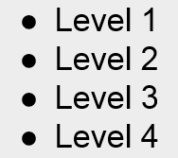
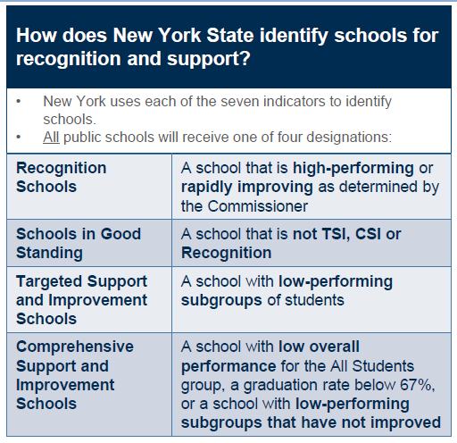
many 4s
many 1s

Slide 11
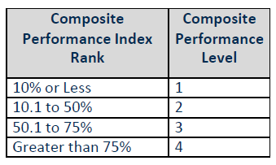
MULTIPLE MEASURES
>75%.......Level 4
50.1-75%.......Level 3
95% students
10.1-50%.......Level 2
only tested students
≤10%.......Level 1

Slide 12
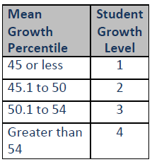
MULTIPLE MEASURES
>54.......Level 4
50.1-54.......Level 3
45.1-50.......Level 2
Mean Growth Percentiles
≤45.......Level 1

Slide 13
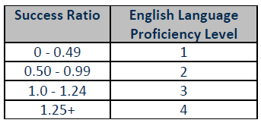
MULTIPLE MEASURES
Entering | Emerging | Transitioning | Expanding | Commanding
1 | 2 | 3 | 4
1 | 2 | 3 | 4
1 | 2 | 3 | 4
1 | 2 | 3 | 4
Proficient
.25
.25
.25
.25
.25
.25
.25
.25
.25
.25
.25
.25
.25
.25

Slide 14
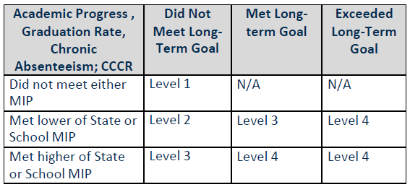
MULTIPLE MEASURES
Long Term Goal
Measures of Interim Progress
(aka +1/5)

Slide 15
MULTIPLE MEASURES
Long Term Goal
4 Year/5 Year/6 Year
Measures of Interim Progress
(aka +1/5)

Slide 16
MULTIPLE MEASURES
Long Term Goal
≥10%
Measures of Interim Progress
(aka +1/5)

Slide 17
MULTIPLE MEASURES
Long Term Goal
Measures of Interim Progress
(aka +1/5)

Slide 19
Comparison to State and local long term goals and MIPs

Slide 20
Comparison to State and local long term goals and MIPs

Slide 22
Informational Purposes Only

Slide 23
All students enrolled BEDS day of Year 4 who
first entered Gr 9 anywhere four years previously
The 2013 cohort entered gr 9 September 2013 (4 year completion June 2017)
and
All ungraded students who
reached 17th birthday of that same school year

Slide 24
ESSA

Slide 25
ESSA
Edition

Slide 26
THINGS TO KNOW ABOUT ESSA
$1.6 Billion
#10- Every Student Succeeds Act

Slide 27
THINGS TO KNOW ABOUT ESSA
Academic Achievement
Graduation Rate
ELL Proficiency
Chronic Absenteeism
College, Career & Civic Readiness
#9- Multiple Measures of Accountability

Slide 28
THINGS TO KNOW ABOUT ESSA
MHSL
PES
WSL
ALG
APHS
Building Level Calculations on Multiple Measures
#8- Shared Faculty Ownership

Slide 29
THINGS TO KNOW ABOUT ESSA
Regents Diploma
CDOS
HSE
NYSAA
Local Diploma
AP exams
CTE
Seal of Biliteracy
#7- Recognizes a variety
of student outcomes

Slide 30
THINGS TO KNOW ABOUT ESSA
Achievement
Growth
#6- States establish their own goals

Slide 31
THINGS TO KNOW ABOUT ESSA
All Students
American Indian or Alaskan Native
Black or African American
Multiracial
Asian or Native Hawaiian/ Other Pacific Islander
Hispanic or Latino
White
English Language Learner (ELL)
Students with Disabilities (SWD)
Economically Disadvantaged
#5- Subgroup Performance Counts

Slide 32
THINGS TO KNOW ABOUT ESSA
Chronic Absenteeism
Graduation Rate
4 Year
5 Year
6 Year
≥10%
#4- Chronic Absenteeism and
Graduation Rates are measured

Slide 33
THINGS TO KNOW ABOUT ESSA
2021-2022
2016-2017
#3- Incremental Growth Expectations

Slide 34
THINGS TO KNOW ABOUT ESSA
#2- 95% participation is still expected

Slide 35
THINGS TO KNOW ABOUT ESSA
#1- Growth and Progress Towards Goals count more than Achievement

